Slide 1
AVR Microcontroller
Microprocessor Course
Chapter 9
AVR TIMER PROGRAMMING IN
ASSEMBLY AND C
Azar1401 (ver 1.3)

Slide 2
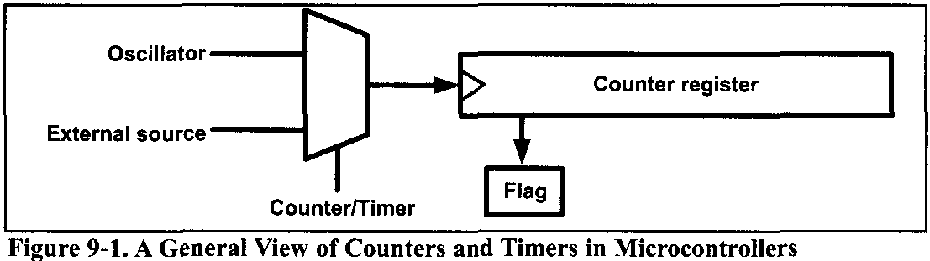
AVR TIMER PROGRAMMING IN ASSEMBLY
Many applications need to count an event or generate time delays. So, there are counter registers in microcontrollers for this purpose.
In the microcontrollers, there is a flag for each of the counters. The flag is set when the counter overflows, and it is cleared by software.
Notes:
When we want to count an event, we connect the external event source to the clock pin of the counter register. Then, when an event occurs externally, the content of the counter is incremented; in this way, the content of the counter represents how many times an event has occurred. When we want to generate time delays, we connect the oscillator to the clock pin of the counter. So, when the oscillator ticks, the content of the counter is incremented. As a result, the content of the counter register represents how many ticks have occurred from the time we have cleared the counter. Since the speed of the oscillator in a microcontroller is known, we can calculate the tick period, and from the content of the counter register we will know how much time has elapsed.

Slide 3
AVR TIMER PROGRAMMING IN ASSEMBLY
HOW TO GENERATE DELAYS
So, one way to generate a time delay is to clear the counter at the start time and wait until the counter reaches a certain number.
The second method to generate a time delay is to load the counter register and wait until the counter overflows and the flag is set.
The AVR has one to six timers depending on the family member. They are referred to as Timers 0, 1, 2, 3, 4 and 5. They can be used as timers to generate a time delay or as counters to count events happening outside the microcontroller.
Counter/Timer

Slide 4
AVR TIMER PROGRAMMING IN ASSEMBLY
In the AVR some of the timers/counters are 8-bit and some are 16-bit.
In ATmega32, there are three timers: Timer0, Timer1, and Timer2.
Timer0 and Timer2 are 8-bit, while Timer1 is 16-bit.

Slide 5
AVR TIMER PROGRAMMING IN ASSEMBLY 9.1 PROGRAMMING TIMERS 0,1 AND 2
Internal Clock
Timer: If we use the internal clock source, then the frequency of the crystal oscillator is fed into the timer. Therefore, it is used for time delay generation and consequently is called a timer.
External Clock
Counter: By choosing the external clock option, we feed pulses through one of the AVR's pins. This is called a counter.

Slide 6
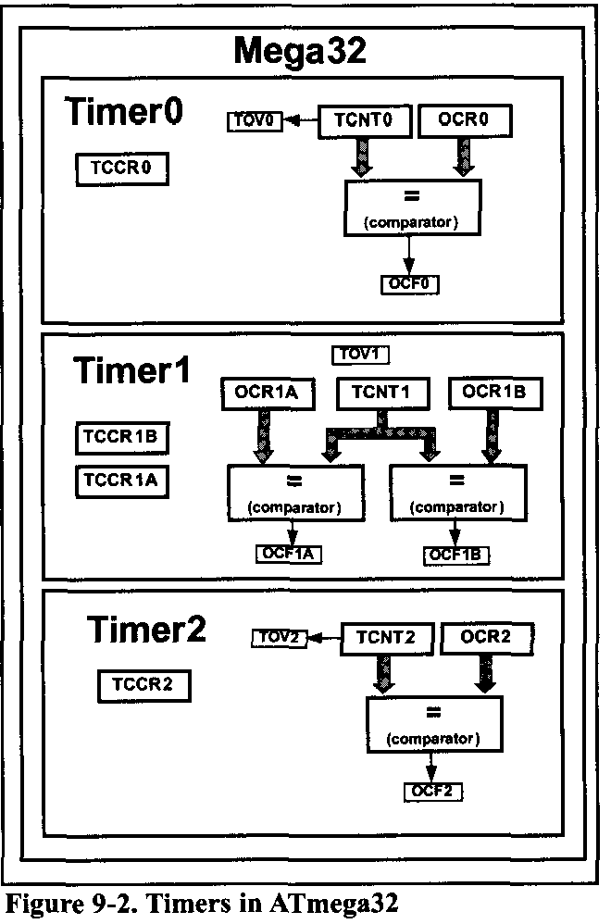
AVR TIMER PROGRAMMING IN ASSEMBLY 9.1 PROGRAMMING TIMERS 0,1 AND 2
Basic registers of timers
For each of the timers, there is a TCNTn (timer/counter) register. The TCNTn register is a counter. Upon reset, the TCNTn contains zero.
Each timer has a TOVn (Timer Overflow) flag, as well. When a timer overflows, its TOVn flag will be set.
Each timer also has the TCCRn (timer/counter control register) register - for setting modes of operation.
Each timer also has an OCRn (Output Compare Register) register. The content of the OCRn is compared with the content of the TCNTn. When they are equal the OCFn (Output Compare Flag) flag will be set.
Notes:
Each timer also has the TCCRn (timer/counter control register) register - for setting modes of operation.

Slide 7

AVR TIMER PROGRAMMING IN ASSEMBLY 9.1 PROGRAMMING TIMERS 0,1 AND 2
The timer registers are located in the I/O register memory.
Therefore, you can read or write from timer registers using IN and OUT instructions, like the other I/O registers. For example, the following instructions load TCNT0 with 25:

Slide 8
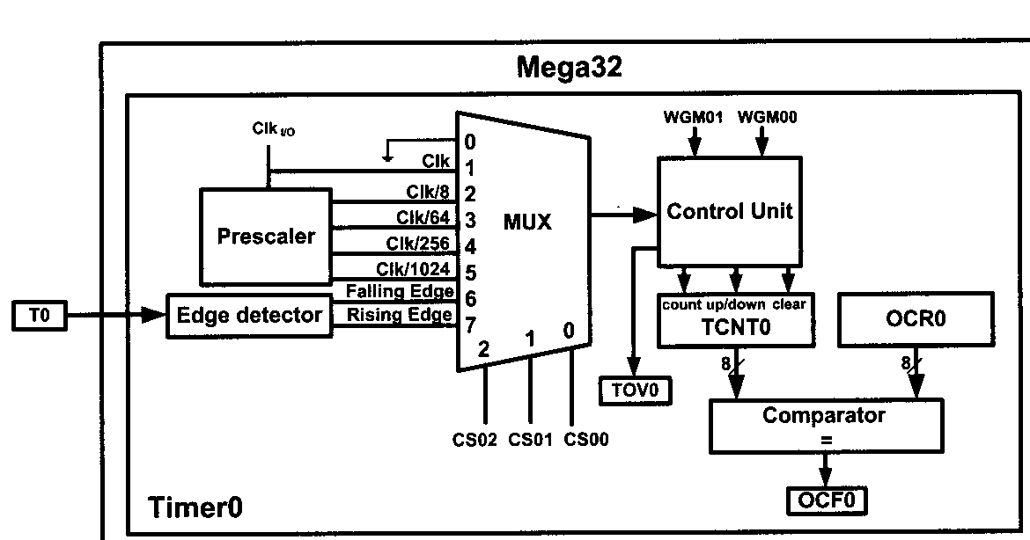
AVR TIMER PROGRAMMING IN ASSEMBLY 9.1 PROGRAMMING TIMERS 0,1 AND 2
The internal structure of the ATmega32 timer0 is shown in followingFigure.

Slide 9
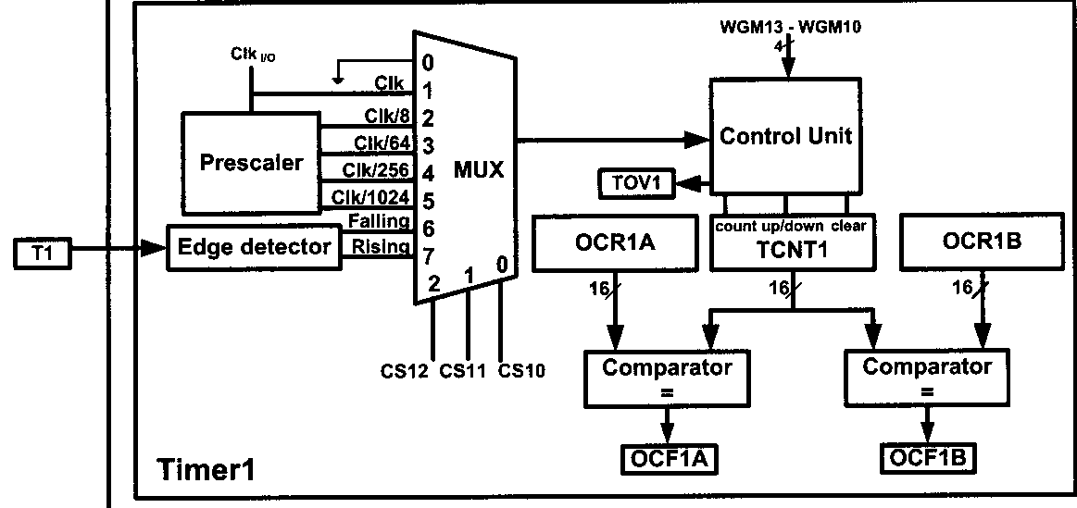
AVR TIMER PROGRAMMING IN ASSEMBLY 9.1 PROGRAMMING TIMERS 0,1 AND 2
The internal structure of the ATmega32 timer1 is shown in Figure 9-3.

Slide 10
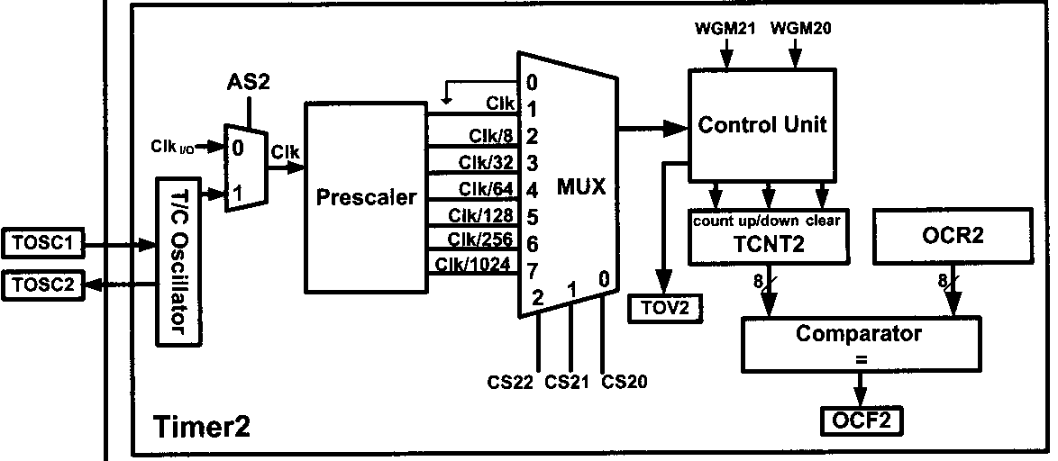
AVR TIMER PROGRAMMING IN ASSEMBLY 9.1 PROGRAMMING TIMERS 0,1 AND 2
The internal structure of the ATmega32 timer2 is shown in Figure 9-3.

Slide 11
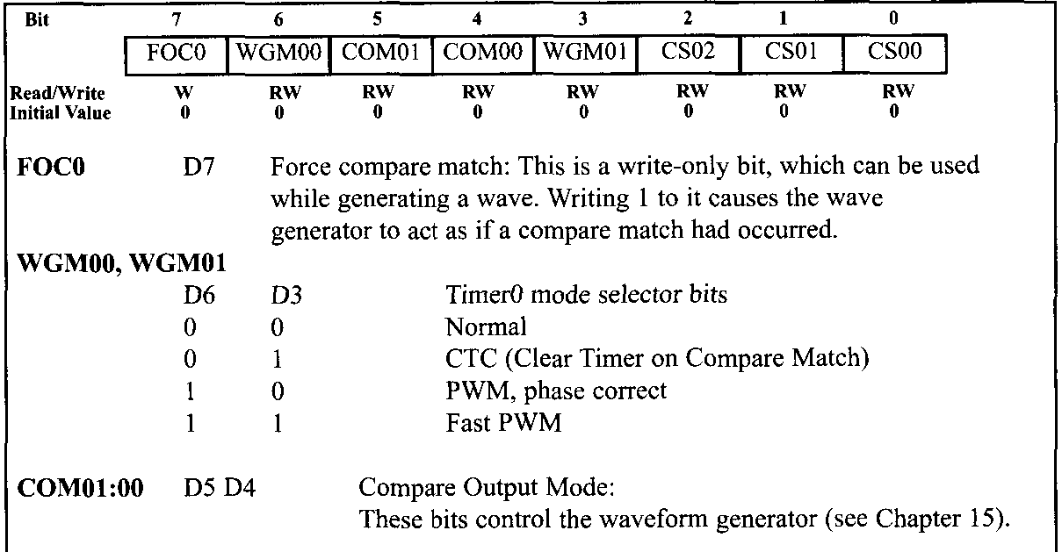
AVR TIMER PROGRAMMING IN ASSEMBLY 9.1 PROGRAMMING TIMERS 0,1 AND 2
TCCR0 (Timer/Counter Control Register)
Timer0 is 8-bit; thus, TCNT0 is 8-bit as shown in Figure 9-4.

Slide 12
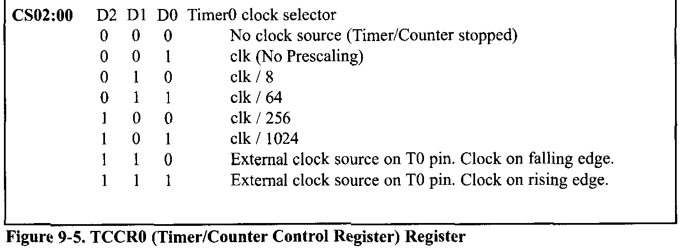
AVR TIMER PROGRAMMING IN ASSEMBLY 9.1 PROGRAMMING TIMERS 0,1 AND 2
TCCR0 (Timer/Counter Control Register) register
TCCR0 is an 8-bit register used for control of Timer0. Bits of this register is shown in Figure 9-5.

Slide 13
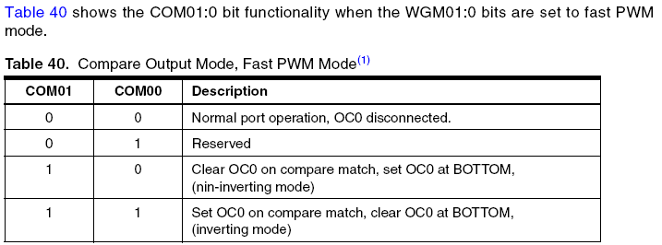
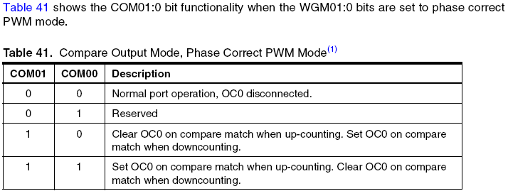
AVR TIMER PROGRAMMING IN ASSEMBLY 9.1 PROGRAMMING TIMERS 0,1 AND 2

Slide 14
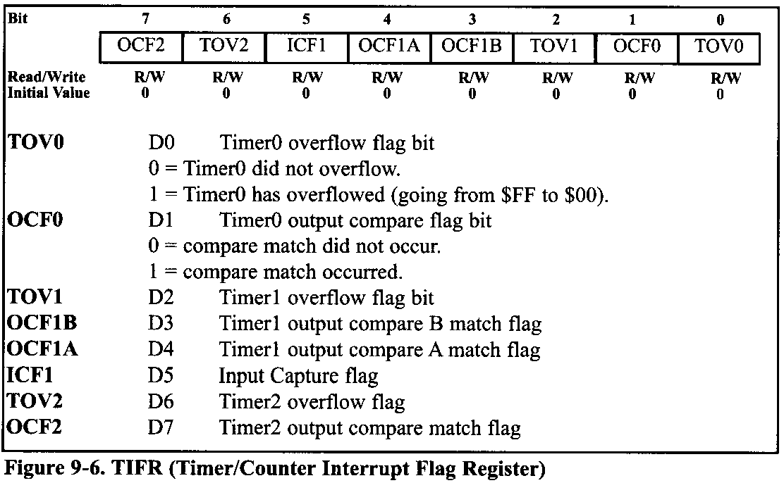
AVR TIMER PROGRAMMING IN ASSEMBLY 9.1 PROGRAMMING TIMERS 0,1 AND 2
TIFR (Timer/counter Interrupt Flag Register) register
The TIFR register contains the flags of different timers.

Slide 15
AVR TIMER PROGRAMMING IN ASSEMBLY 9.1 PROGRAMMING TIMERS 0,1 AND 2
TOV0 (Timer0 Overflow)
when the timer rolls over from $FF to 00, the TOV0 flag is set to 1 and it remains set until the software clears it.
The strange thing about this flag is that in order to clear it we need to write 1 to it.

Slide 16
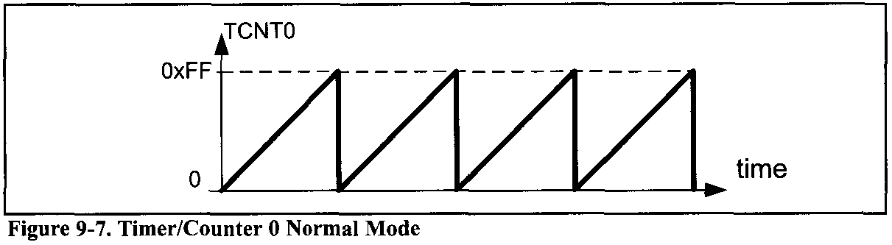
AVR TIMER PROGRAMMING IN ASSEMBLY 9.1 PROGRAMMING TIMERS 0,1 AND 2
Normal mode
In this mode, the content of the timer/counter increments with each clock. It counts up until it reaches its max of 0xFF. When it rolls over from 0xFF to 0x00, it sets high a flag bit called TOV0 (Timer Overflow). This timer flag can be monitored.
Notes:
In this mode, the content of the timer/counter increments with each clock. It counts up until it reaches its max of 0xFF. When it rolls over from 0xFF to 0x00, it sets high a flag bit called TOVO (Timer Overflow). This timer flag can be monitored.

Slide 17
AVR TIMER PROGRAMMING IN ASSEMBLY 9.1 PROGRAMMING TIMERS 0,1 AND 2
Steps to program Timer0 in Normal mode
To generate a time delay using Timer0 in Normal mode, the following steps are taken:
Load the TCNT0 register with the initial count value.
Load the value into the TCCR0 register, indicating which mode (8-bit or 16-bit) is to be used and the prescaler option. When you select the clock source, the timer/counter starts to count, and each tick causes the content of the timer/counter to increment by 1.
Keep monitoring the timer overflow flag (TOV0) to see if it is raised. Get out of the loop when TOV0 becomes high.
Stop the timer by disconnecting the clock source, using the following instructions:
5. Clear the TOV0 flag for the next round.
6. Go back to Step 1 to load TCNT0 again.

Slide 18
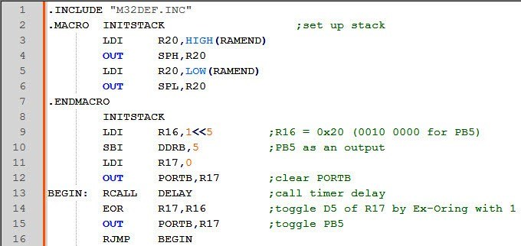
AVR TIMER PROGRAMMING IN ASSEMBLY 9.1 PROGRAMMING TIMERS 0,1 AND 2
Example 9-3
In the following program, we are creating a square wave of 50% duty cycle (with equal portions high and low) on the PORTB.5 bit. Timer0 is used to generate the time delay. Analyze the program.

Slide 19
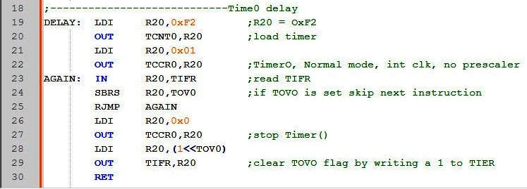
AVR TIMER PROGRAMMING IN ASSEMBLY 9.1 PROGRAMMING TIMERS 0,1 AND 2
Solution:
In the above program notice the following steps:
0xF2 is loaded into TCNT0.
TCCR0 is loaded and Timer0 is started.

Slide 20
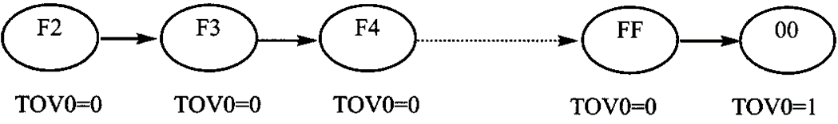
AVR TIMER PROGRAMMING IN ASSEMBLY 9.1 PROGRAMMING TIMERS 0,1 AND 2
Solution:
Timer0 counts up with the passing of each clock, which is provided by the crystal oscillator. As the timer counts up, it goes through the states of F3, F4, F5, F6, F7, F8, F9, FA, FB, and so on until it reaches 0xFF. One more clock rolls it to 0, raising the Timer0 flag (TOV0 = 1). At that point, the "SBRS R20,TOV0" instruction bypasses the "RJMP AGAIN" instruction.
Timer0 is stopped.
The TOV0 flag is cleared.

Slide 21
AVR TIMER PROGRAMMING IN ASSEMBLY 9.1 PROGRAMMING TIMERS 0,1 AND 2
Example 9-4
In Example 9-3, calculate the amount of time delay generated by the timer. Assume that XTAL = 8 MHz.
Solution:
We have 8 MHz as the timer frequency. As a result, each clock has a period of
T = 1/8 MHz = 0.125 µs.
In other words, Timer0 counts up each 0.125 its resulting in delay = number of counts x 0.125 µs.
The number of counts for the rollover is 0xFF-0xF2=0x0D (13 decimal). However, we add one to 13 because of the extra clock needed when it rolls over from FF to 0 and raises the TOV0 flag. This gives 14 x 0.125 = 1.75 µs for half the pulse.

Slide 22
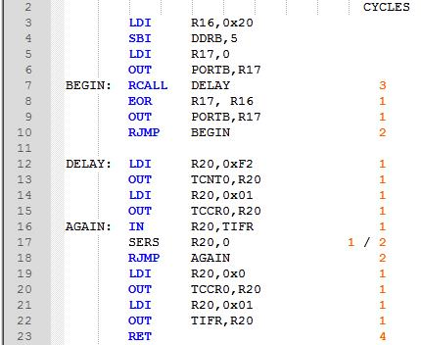
AVR TIMER PROGRAMMING IN ASSEMBLY 9.1 PROGRAMMING TIMERS 0,1 AND 2
Example 9-5
In Example 9-3, calculate the frequency of the square wave generated on pin PORTB.5. Assume that XTAL — 8 MHz.
Solution:
To get a more accurate timing, we need to add clock cycles due to the instructions.

Slide 23
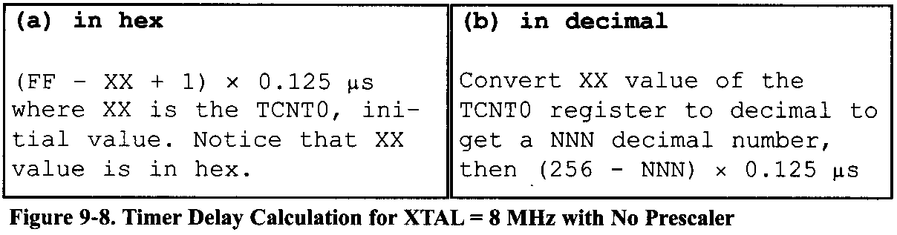
AVR TIMER PROGRAMMING IN ASSEMBLY 9.1 PROGRAMMING TIMERS 0,1 AND 2

Slide 24
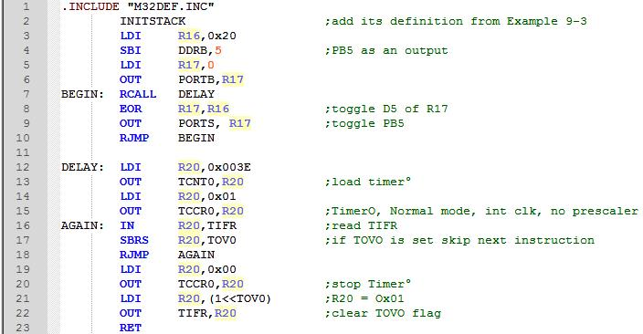
AVR TIMER PROGRAMMING IN ASSEMBLY 9.1 PROGRAMMING TIMERS 0,1 AND 2
Example 9-6
Find the delay generated by Timer0 in the following code, using both of the methods of Figure 9-8. Do not include the overhead due to instructions. (XTAL = 8 MHz)

Slide 25
AVR TIMER PROGRAMMING IN ASSEMBLY 9.1 PROGRAMMING TIMERS 0,1 AND 2
Solution:
(FF - 3E + 1) = 0xC2 = 194 in decimal and 194 x 0.125 µs = 24.25 µs.
Because TCNT0 = 0x3E = 62 (in decimal) we have 256 - 62 =194. This means that the timer counts from 0x3E to 0xFF. This plus rolling over to 0 goes through a total of 194 clock cycles, where each clock is 0.125 µs in duration. Therefore, we have 194 x 0.125 µs = 24.25 µs as the width of the pulse.

Slide 26
AVR TIMER PROGRAMMING IN ASSEMBLY 9.1 PROGRAMMING TIMERS 0,1 AND 2
Finding values to be loaded into the timer
Assuming that we know the amount of timer delay we need, the question is how to find the values needed for the TCNT0 register. To calculate the values to be loaded into the TCNT0 registers, we can use the following steps:
Calculate the period of the timer clock using the following formula: Tclock = 1/FTimer
where FTimer is the frequency of the clock used for the timer. For example, in no prescaler mode, Ftimer=FOscillator. Tclock gives the period at which the timer increments.
Divide the desired time delay by Tclock. This says how many clocks we need.
Perform 256 - n, where n is the decimal value we got in Step 2.
4. Convert the result of Step 3 to hex, where xx is the initial hex value to be loaded into the timer's register.
5. Set TCNT0 = xx.

Slide 27
AVR TIMER PROGRAMMING IN ASSEMBLY 9.1 PROGRAMMING TIMERS 0,1 AND 2
Example 9-7
Assuming that XTAL = 8 MHz, write a program to generate a square wave with a period of 12.5 µs on pin PORTB.3.
Solution:
For a square wave with T = 12.5 µs we must have a time delay of 6.25 µs. Because XTAL = 8 MHz, the counter counts up every 0.125 µs. This means that we need 6.25 µs / 0.125 us = 50 clocks. 256 - 50 = 206 = 0xCE. Therefore, we have TCNT0 = 0xCE.

Slide 28
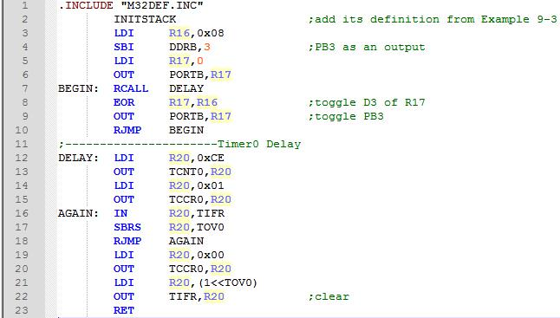
AVR TIMER PROGRAMMING IN ASSEMBLY 9.1 PROGRAMMING TIMERS 0,1 AND 2

Slide 29
AVR TIMER PROGRAMMING IN ASSEMBLY 9.1 PROGRAMMING TIMERS 0,1 AND 2
Example 9-8
Assuming that XTAL = 8 MHz, modify the program in Example 9-7 to generate a square wave of 16 kHz frequency on pin PORTB.3.
Solution:
Look at the following steps.
T = 1 / F = 1 / 16 kHz = 62.5µs the period of the square wave.
1/2 of it for the high and low portions of the pulse is 31.25 µs.
31.25 µs / 0.125 µs = 250 and 256 - 250 = 6, which in hex is 0x06.
TCNT0 = 0x06.

Slide 30
AVR TIMER PROGRAMMING IN ASSEMBLY 9.1 PROGRAMMING TIMERS 0,1 AND 2
Using the Windows calculator to find TCNT0
The calculator in Windows is a handy tool to find the TCNT0 value. Assume that we would like to find the TCNT0 value for a time delay that uses 135 clocks of 0.125 μs. The following steps show the calculation:
Bring up the scientific calculator in MS Windows and select decimal.
Enter 135.
Select hex. This converts 135 to hex, which is 0x87.
Select +/- to give -135 decimal (0x79).
The lowest two digits (79) of this hex value are for TCNT0. We ignore all the Fs on the left because our number is 8-bit data.

Slide 31
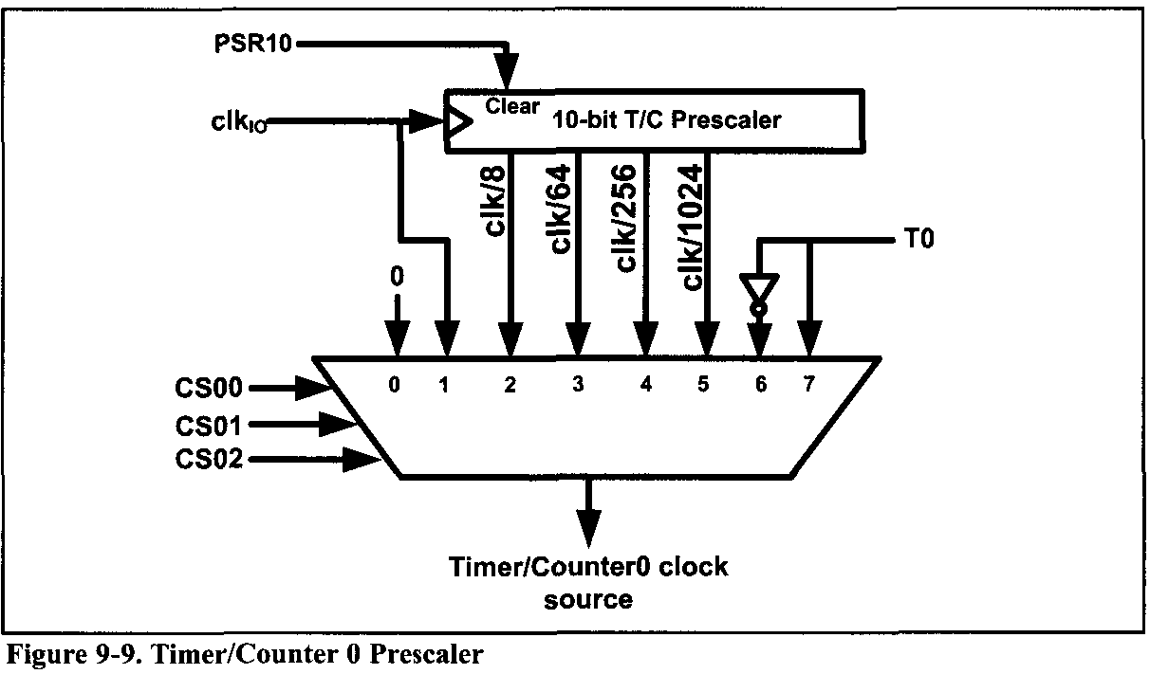
AVR TIMER PROGRAMMING IN ASSEMBLY 9.1 PROGRAMMING TIMERS 0,1 AND 2
Prescaler and generating a large time delay
As we have seen in the examples so far, the size of the time delay depends on two factors,
the crystal frequency, and
the timer's 8-bit register.
Both of these factors are beyond the control of the AVR programmer.

Slide 32
AVR TIMER PROGRAMMING IN ASSEMBLY 9.1 PROGRAMMING TIMERS 0,1 AND 2
Example 9-9
Modify TCNT0 in Example 9-7 to get the largest time delay possible. Find the delay in ms. In your calculation, exclude the overhead due to the instructions in the loop.
Solution:
To get the largest delay we make TCNT0 zero. This will count up from 00 to 0xFF and then roll over to zero.
Making TCNT0 zero means that the timer will count from 00 to 0xFF, and then will roll over to raise the TCNT0 flag. As a result, it goes through a total of 256 states. Therefore, we have delay = (256 - 0) x 0.125 µs = 32 µs . That gives us the smallest frequency of 1 / (2 x 32 µs) - 1 / (64 µs ) = 15.625 kHz.

Slide 33
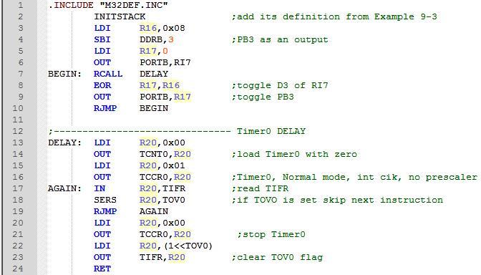
AVR TIMER PROGRAMMING IN ASSEMBLY 9.1 PROGRAMMING TIMERS 0,1 AND 2

Slide 34
AVR TIMER PROGRAMMING IN ASSEMBLY 9.1 PROGRAMMING TIMERS 0,1 AND 2
We saw in Example 9-9 that the largest time delay is achieved by making TCNT0 zero. What if that is not enough?
We can use the prescaler option in the TCCR0 register to increase the delay by reducing the period. The prescaler option of TCCR allows us to divide the instruction clock by a factor of 8 to 1024 as was shown in Figure 9-5. The prescaler of Timer/Counter0 is shown in Figure 9-9.
Notes:
We saw in Example 9-9 that the largest time delay is achieved by making TCNT0 zero. What if that is not enough? We can use the prescaler option in the TCCR0 register to increase the delay by reducing the period. The prescaler option of TCCR allows us to divide the instruction clock by a factor of 8 to 1024 as was shown in Figure 9-5. The prescaler of Timer/Counter 0 is shown in Figure 9-9.

Slide 35
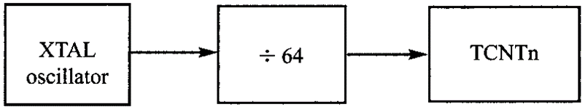
AVR TIMER PROGRAMMING IN ASSEMBLY 9.1 PROGRAMMING TIMERS 0,1 AND 2
Example 9-10
Find the timer's clock frequency and its period for various AVR-based systems, with the following crystal frequencies. Assume that a prescaler of 1:64 is used.
(a) 8 MHz (b) 16 MHz (c) 10 MHz
Solution:
1/64×8 MHz=125 kHz due to 1:64 prescaler and T =1/125 kHz= 8 µs
1/64×16 MHz= 250 kHz due to prescaler and T = 1/250 kHz = 4 µs
1/64×10 MHz=156.2 kHz due to prescaler and T=1/156 kHz = 6.4 µs

Slide 36
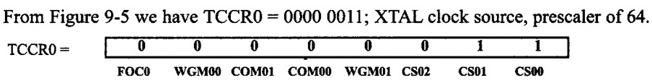
AVR TIMER PROGRAMMING IN ASSEMBLY 9.1 PROGRAMMING TIMERS 0,1 AND 2
Example 9-11
Find the value for TCCR0 if we want to program Timer0 in Normal mode with a prescaler of 64 using internal clock for the clock source.
Solution:
From Figure 9-5 we have TCCR0 = 0000 0011; XTAL clock source, prescaler of 64.

Slide 37
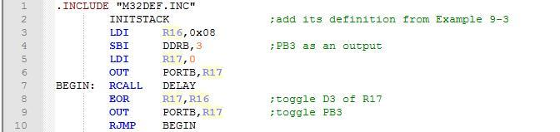
AVR TIMER PROGRAMMING IN ASSEMBLY 9.1 PROGRAMMING TIMERS 0,1 AND 2
Example 9-12
Examine the following program and find the time delay in seconds. Exclude the over-head due to the instructions in the loop. Assume XTAL = 8 MHz.

Slide 38
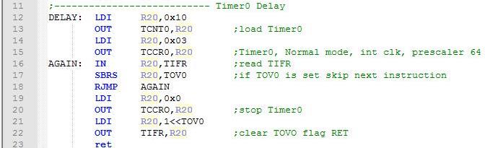
AVR TIMER PROGRAMMING IN ASSEMBLY 9.1 PROGRAMMING TIMERS 0,1 AND 2
Solution:
TCNT0 = 0x10 = 16 in decimal and 256 - 16 = 240.
Now 240 × 64 × 0.125 µs = 1920 µs ,

Slide 39
AVR TIMER PROGRAMMING IN ASSEMBLY 9.1 PROGRAMMING TIMERS 0,1 AND 2
Example 9-13
Assume XTAL = 8 MHz.
Find the clock period fed into Timer0 if a prescaler option of 1024 is chosen.
Show what is the largest time delay we can get using this prescaler option and Timer0.
Solution:
8MHz×1/1024=7812.5 Hz due to 1:1024 prescaler and T = 1/7812.5 Hz = 128 ms = 0.128 s
To get the largest delay, we make TCNT0 zero. Making TCNT0 zero means that the timer will count from 00 to 0xFF, and then roll over to raise the TOV0 flag. As a result, it goes through a total of 256 states. Therefore, we have delay=(256 - 0)×128 µs=32,768 µs=0.032768 seconds.

Slide 40
AVR TIMER PROGRAMMING IN ASSEMBLY 9.1 PROGRAMMING TIMERS 0,1 AND 2
Example 9-14
Assuming XTAL = 8 MHz, write a program to generate a square wave of 125 Hz frequency on pin PORTB.3. Use Timer0, Normal mode, with prescaler = 256.
Solution:
Look at the following steps:
T = 1 / 125 Hz = 8 ms, the period of the square wave.
1/2 of it for the high and low portions of the pulse = 4 ms
(4 ms / 0.125 gs) / 256 = 125 and 256 -125 = 131 in decimal, and in hex it is 0x83.
TCNT0 = 83 (hex)

Slide 41
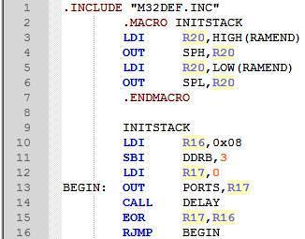
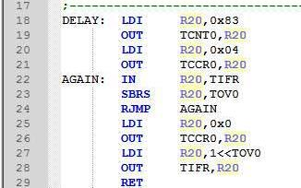
AVR TIMER PROGRAMMING IN ASSEMBLY 9.1 PROGRAMMING TIMERS 0,1 AND 2

Slide 42
AVR TIMER PROGRAMMING IN ASSEMBLY 9.1 PROGRAMMING TIMERS 0,1 AND 2
Assemblers and negative values
Because the timer is in 8-bit mode, we can let the assembler calculate the value for TCNT0. For example, in the “LDI R20,-100” instruction, the assembler will calculate the -100 = 9C and make R20 = 9C in hex. This makes our job easier. See Examples 9-15 and 9-16.
Example 9-15
Find the value (in hex) loaded into TCNT0 for each of the following cases.
Solution:
You can use the Windows scientific calculator to verify the results provided by the assembler. In the Windows calculator, select decimal and enter 200. Then select hex, then +1- to get the negative value. The following is what we get.
Decimal 2's complement (TCNT0 value)
-200 0x38
-60 0xC4
-12 0xF4

Slide 43
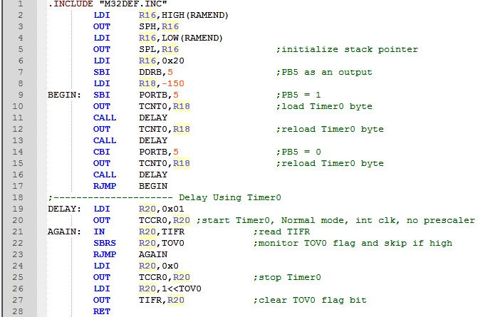
AVR TIMER PROGRAMMING IN ASSEMBLY 9.1 PROGRAMMING TIMERS 0,1 AND 2
Example 9-16
Find
the frequency of the square wave generated in the following code, and
the duty cycle of this wave. Assume XTAL = 8 MHz.

Slide 44
AVR TIMER PROGRAMMING IN ASSEMBLY 9.1 PROGRAMMING TIMERS 0,1 AND 2
Solution:
For the TCNT0 value in 8-bit mode, the conversion is done by the assembler as long as we enter a negative number. This also makes the calculation easy. Because we are using 150 clocks, we have
time for the DELAY subroutine = 150 × 0.125 µs = 18.75 µs.
The high portion of the pulse is twice the size of the low portion (66% duty cycle).
Therefore, we have: T = high portion + low portion = 2 × 18.75 µs +18.75 µs = 56.25 µs and frequency = 1 / 56.25 µs = 17.777 kHz.

Slide 45
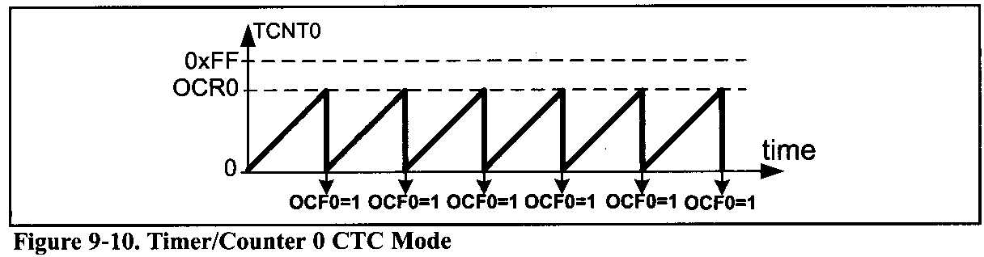
AVR TIMER PROGRAMMING IN ASSEMBLY 9.1 PROGRAMMING TIMERS 0,1 AND 2
CTC mode programming (Clear Timer0 on compare match)
The OCR0 register is used with CTC mode. As with the Normal mode, in the CTC mode, the timer is incremented with a clock. But it counts up until the content of the TCNT0 register becomes equal to the content of OCR0 (compare match occurs); then, the timer will be cleared and the OCF0 flag will be set when the next clock occurs. The OCF0 flag is located in the TIFR register.

Slide 46
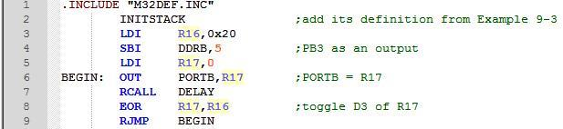
AVR TIMER PROGRAMMING IN ASSEMBLY 9.1 PROGRAMMING TIMERS 0,1 AND 2
Example 9-17
In the following program, we are creating a square wave of 50% duty cycle (with equal portions high and low) on the PORTB.5 bit. Timer0 is used to generate the time delay. Analyze the program.

Slide 47
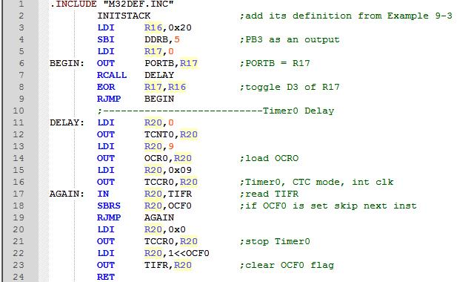
AVR TIMER PROGRAMMING IN ASSEMBLY 9.1 PROGRAMMING TIMERS 0,1 AND 2

Slide 48
AVR TIMER PROGRAMMING IN ASSEMBLY 9.1 PROGRAMMING TIMERS 0,1 AND 2
Solution:
In the above program notice the following steps:
9 is loaded into OCR0.
TCCR0 is loaded and Timer0 is started.
Timer0 counts up with the passing of each clock, which is provided by the crystal oscillator. As the timer counts up, it goes through the states of 00, 01, 02, 03, and so on until it reaches 9. One more clock rolls it to 0, raising the Timer0 compare match flag (OCF0 = 1). At that point, the "SBRS R20,OCF0" instruction bypasses the "RJMP AGAIN" instruction.
Timer0 is stopped.
The OCF0 flag is cleared.

Slide 49
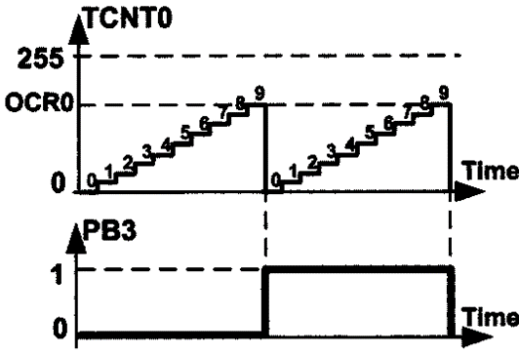
AVR TIMER PROGRAMMING IN ASSEMBLY 9.1 PROGRAMMING TIMERS 0,1 AND 2
Example 9-18
Find the delay generated by Timer0 in Example 9-17. Do not include the overhead due to instructions. (XTAL = 8 MHz)
Solution:
OCR0 is loaded with 9 and TCNT0 is cleared; Thus, after 9 clocks TCNT0 becomes equal to OCR0. On the next clock, the OCF0 flag is set and the reset occurs. That means the TCNT0 is cleared after 9 + 1 = 10 clocks. Because XTAL = 8 MHz, the counter counts up every 0.125 µs. Therefore, we have
10 × 0.125 µs = 1.25 µs.

Slide 50
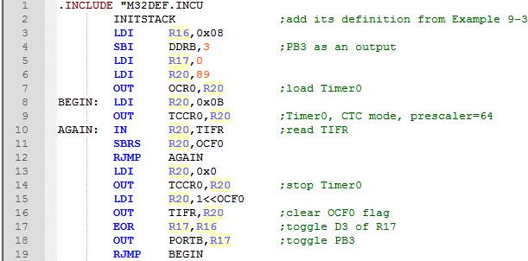
AVR TIMER PROGRAMMING IN ASSEMBLY 9.1 PROGRAMMING TIMERS 0,1 AND 2
Example 9-19
Find the delay generated by Timer0 in the following program. Do not include the overhead due to instructions. (XTAL = 8 MHz)

Slide 51
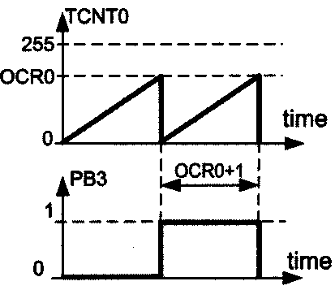
AVR TIMER PROGRAMMING IN ASSEMBLY 9.1 PROGRAMMING TIMERS 0,1 AND 2
Due to prescaler = 64 each timer clock lasts 64 × 0.125 μs = 8μs. OCR0 is loaded with 89; thus, after 90 clocks OCF0 is set.
Therefore we have 90 × 8 μs = 720 μs.

Slide 52
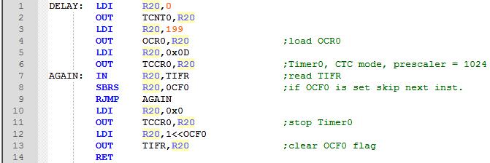
AVR TIMER PROGRAMMING IN ASSEMBLY 9.1 PROGRAMMING TIMERS 0,1 AND 2
Example 9-20
Assuming XTAL = 8 MHz, write a program to generate a delay of 25.6 ms. Use Timer0, CTC mode, with prescaler = 1024.
Solution:
Due to prescaler = 1024 each timer clock lasts 1024 x 0.125 µs = 1280. Thus, in order to generate a delay of 25.6 ms we should wait 25.6 ms / 128 µs = 200 clocks. Therefore the OCR0 register should be loaded with 200 - 1 = 199.

Slide 53
AVR TIMER PROGRAMMING IN ASSEMBLY 9.1 PROGRAMMING TIMERS 0,1 AND 2
Notice that the comparator checks for equality; thus, if we load the OCR0 register with a value that is smaller than TCNT0's value, the counter will miss the compare match and will count up until it reaches the maximum value of $FF and rolls over.
This causes a big delay and is not desirable in many cases.

Slide 54
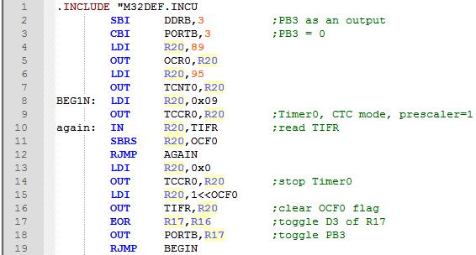
AVR TIMER PROGRAMMING IN ASSEMBLY 9.1 PROGRAMMING TIMERS 0,1 AND 2
Example 9-22
In the following program, how long does it take for the PB3 to become one? Do not include the overhead due to instructions. (XTAL = 8 MHz)

Slide 55
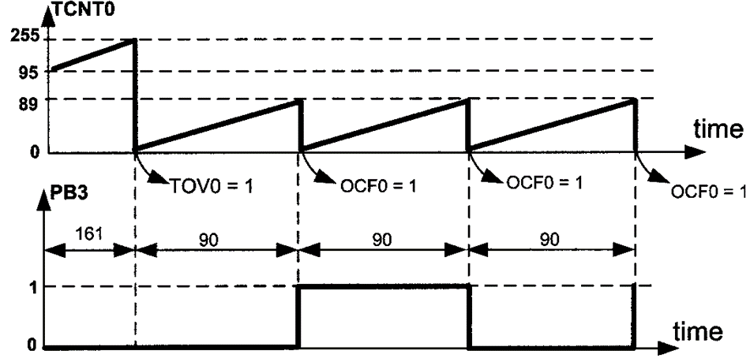
AVR TIMER PROGRAMMING IN ASSEMBLY 9.1 PROGRAMMING TIMERS 0,1 AND 2
Solution:
Since the value of TCNT0 (95) is bigger than the content of OCR0 (89), the timer counts up until it gets to $FF and rolls over to zero. The TOV0 flag will be set as a result of the overflow. Then, the timer counts up until it becomes equal to 89 and compare match occurs. Thus, the first compare match occurs after 161 + 90 = 251 clocks, which means after 251 × 0.125 µs = 31.375 µs. The next compare matches occur after 90 clocks, which means after 90 × 0.125 µs = 11.25 µs.

Slide 56
AVR TIMER PROGRAMMING IN ASSEMBLY 9.1 PROGRAMMING TIMERS 0,1 AND 2
Timer2 programming
Timer2 is an 8-bit timer. Therefore it works the same way as Time0. But there are two differences between Timer0 and Timer2:
Timer2 can be used as a real time counter. To do so, we should connect a crystal of 32.768 kHz to the TOSCl and TOSC2 pins of AVR and set the AS2 bit. See Figure 9-12.
In Timer0, when CS02-CS00 have values 110 or 111, Timer0 counts the external events. But in Timer2, the multiplexer selects between the different scales of the clock. In other words, the same values of the CS bits can have different meanings for Timer0 and Timer2. Compare Figure 9-11 with Figure 9-5 and examine Examples 9-23 through 9-25.

Slide 57
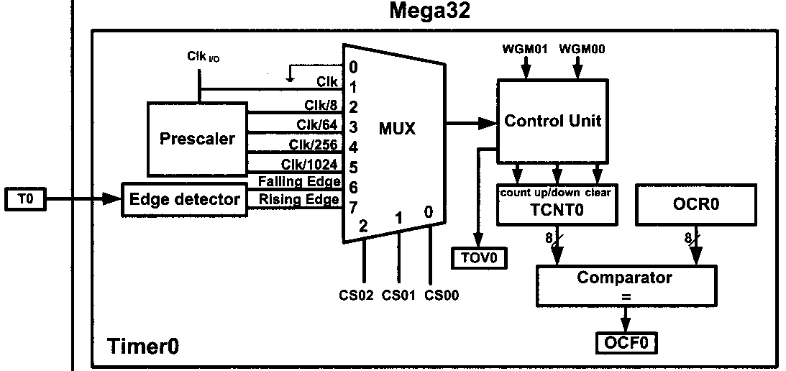
AVR TIMER PROGRAMMING IN ASSEMBLY 9.1 PROGRAMMING TIMERS 0,1 AND 2
Timer2 programming
Figure 9-13 Atmega32 Timer

Slide 58

AVR TIMER PROGRAMMING IN ASSEMBLY 9.1 PROGRAMMING TIMERS 0,1 AND 2
Timer2 programming
Figure 9-13 Atmega32 Timer

Slide 59
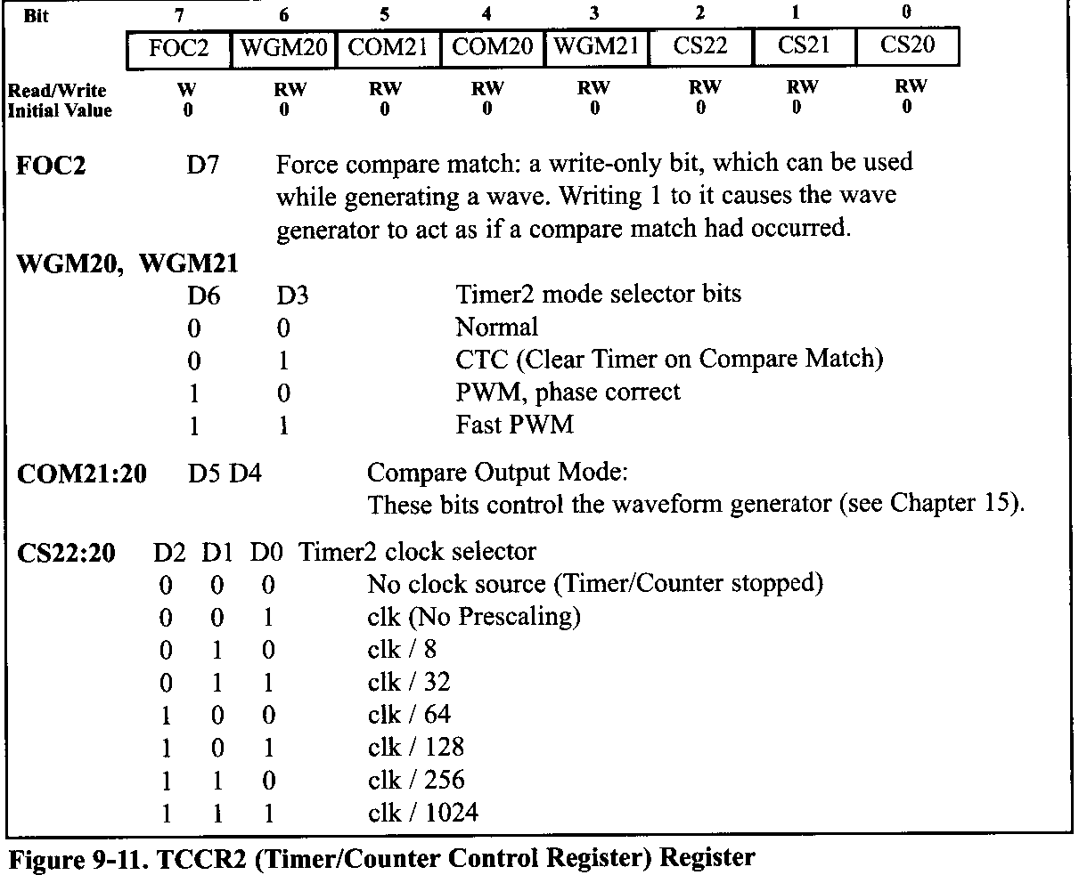
AVR TIMER PROGRAMMING IN ASSEMBLY 9.1 PROGRAMMING TIMERS 0,1 AND 2

Slide 60
AVR TIMER PROGRAMMING IN ASSEMBLY 9.1 PROGRAMMING TIMERS 0,1 AND 2
Example 9-23
Find the value for TCCR2 if we want to program Timer2 in normal mode with a prescaler of 64 using internal clock for the clock source.
Solution:
From Figure 9-11 we have TCCR2 = 0000 0100; XTAL clock source, prescaler of 64.
Compare the answer with Example 9-11.

Slide 61
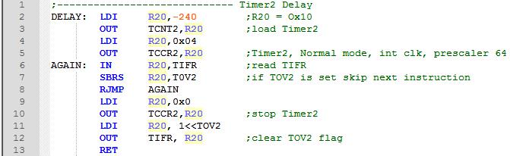
AVR TIMER PROGRAMMING IN ASSEMBLY 9.1 PROGRAMMING TIMERS 0,1 AND 2
Example 9-24
Using a prescaler of 64, write a program to generate a delay of 1920 µs. Assume XTAL 8 MHz.
Solution:
Timer clock = 8 MHz/64 = 125 kHz ⇒ Timer Period = 1 / 125 kHz = 8 µs ⇒
Timer Value = 1920 µs / 8 µs = 240
Compare the above program with the DELAY subroutine in Example 9-12. There are two differences between the two programs:
1- The register names are different. TCNT2 instead of TCNT0
2-The values of TCCRn are different for the same prescaler.

Slide 62
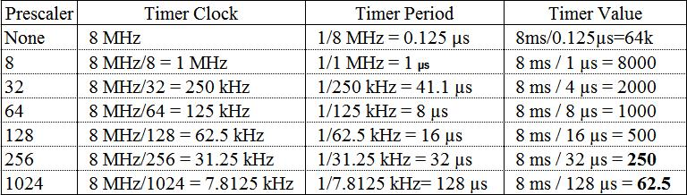
AVR TIMER PROGRAMMING IN ASSEMBLY 9.1 PROGRAMMING TIMERS 0,1 AND 2
Example 9-25
Using CTC mode, write a program to generate a delay of 8 ms. Assume XTAL = 8 MHz
Solution:
As XTAL = 8 MHz, the different outputs of the prescaler are as follows:
From the above calculation we can only use options Prescaler = 256 or Prescaler = 1024. We should use the option Prescaler = 256 since we cannot use a decimal point. To wait 250 clocks we should load OCR2 with 250 - 1 = 249.

Slide 63
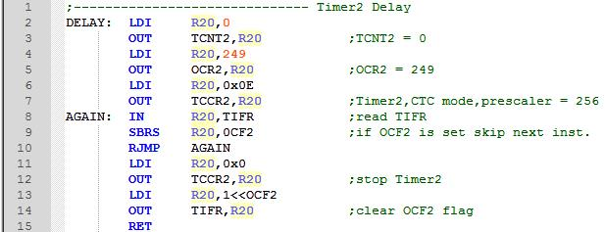
AVR TIMER PROGRAMMING IN ASSEMBLY 9.1 PROGRAMMING TIMERS 0,1 AND 2
Example 9-25 (Cont.)

Slide 64
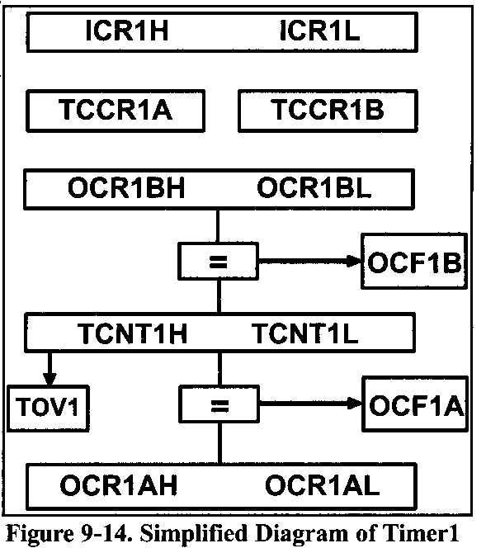
AVR TIMER PROGRAMMING IN ASSEMBLY 9.1 PROGRAMMING TIMERS 0,1 AND 2
Timer1 programming
Timer1 has the prescaler options of 1:1, 1:8, 1:64, 1:256, and 1:1024.
There are two registers in Timer1: OCR1A and OCR1B.

Slide 65
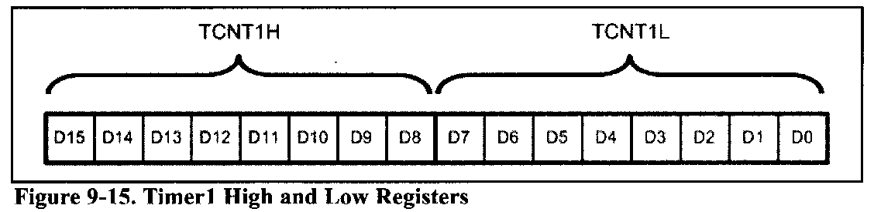
AVR TIMER PROGRAMMING IN ASSEMBLY 9.1 PROGRAMMING TIMERS 0,1 AND 2
Timer/Counter 16-bit
As Timer1 is a 16-bit timer, the OCR registers are 16-bit registers as well and they are made of two 8-bit registers. For example, OCR1A is made of OCR1AH (OCR1A high byte) and OCR1AL (OCR1A low byte).

Slide 66
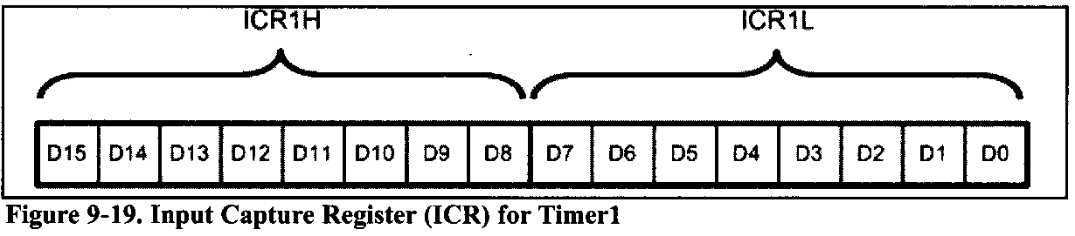
AVR TIMER PROGRAMMING IN ASSEMBLY 9.1 PROGRAMMING TIMERS 0,1 AND 2
Input Capture Register
There is also an auxiliary register named ICR1, which is used in operations such as capturing. ICR1 is a 16-bit register made of ICR1H and ICR1L.

Slide 67
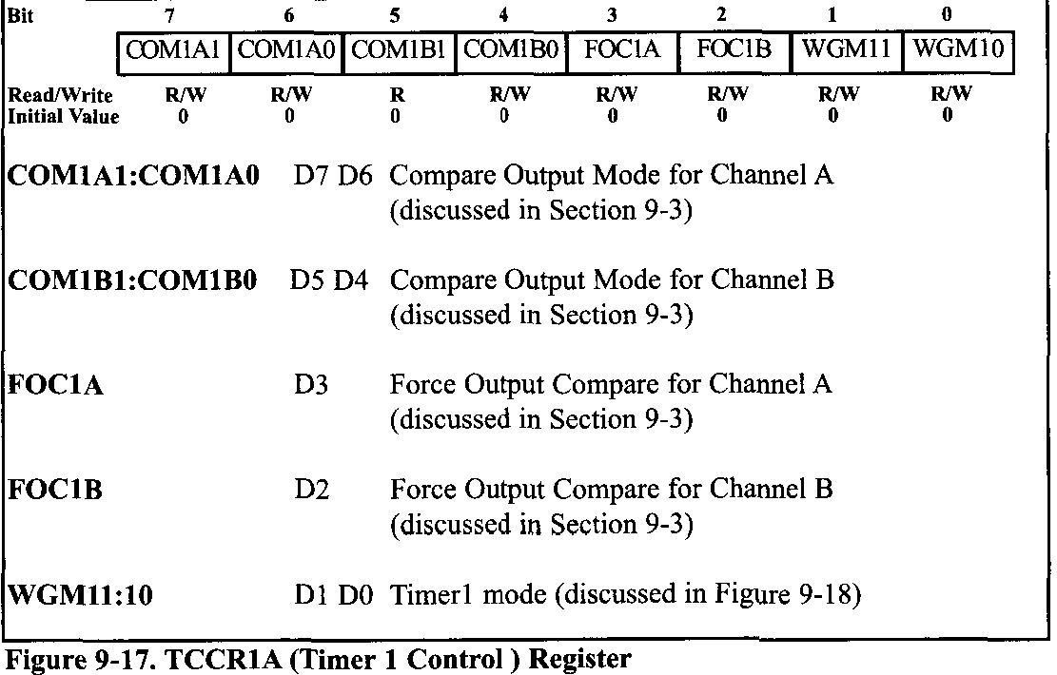
AVR TIMER PROGRAMMING IN ASSEMBLY 9.1 PROGRAMMING TIMERS 0,1 AND 2
TCCR1A Control Register

Slide 68
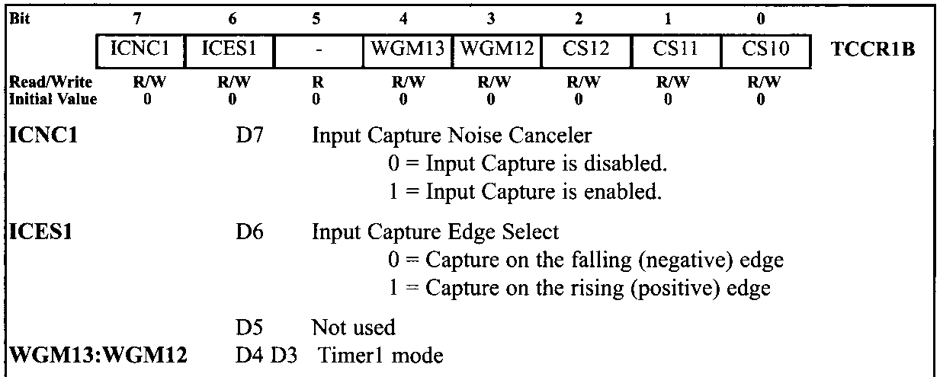
AVR TIMER PROGRAMMING IN ASSEMBLY 9.1 PROGRAMMING TIMERS 0,1 AND 2
TCCR1B Control Register – Figure 9-18

Slide 69
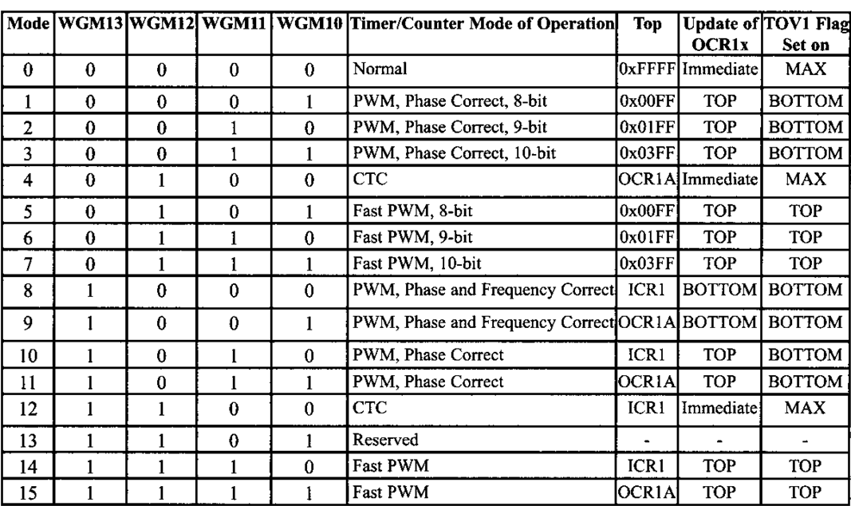
AVR TIMER PROGRAMMING IN ASSEMBLY 9.1 PROGRAMMING TIMERS 0,1 AND 2
TCCR1B Control Register – Figure 9-18

Slide 70
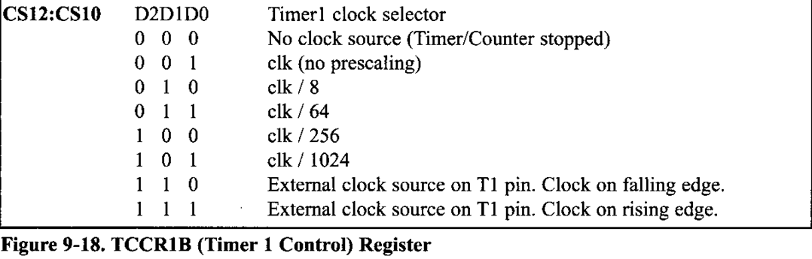
AVR TIMER PROGRAMMING IN ASSEMBLY 9.1 PROGRAMMING TIMERS 0,1 AND 2
TCCR1B Control Register – Figure 9-18

Slide 71
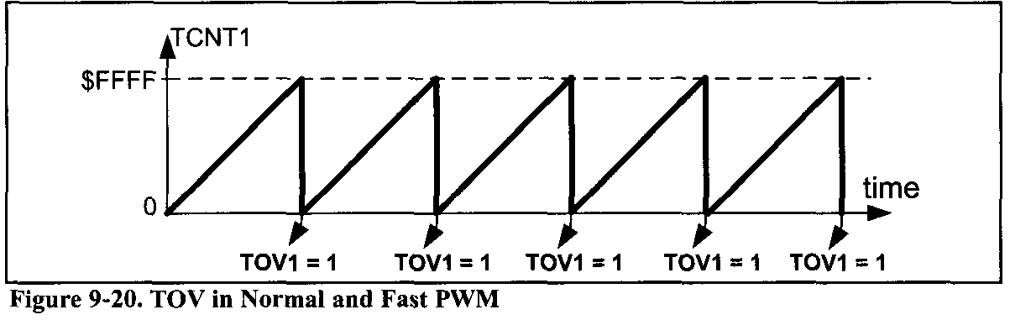
AVR TIMER PROGRAMMING IN ASSEMBLY 9.1 PROGRAMMING TIMERS 0,1 AND 2
Timer1 operation modes
Normal mode (WGM13:10 = 0000)
In this mode, the timer counts up until it reaches $FFFF and then it rolls over from $FFFF to 0000. When the timer rolls over, the TOV1 flag will be set.

Slide 72
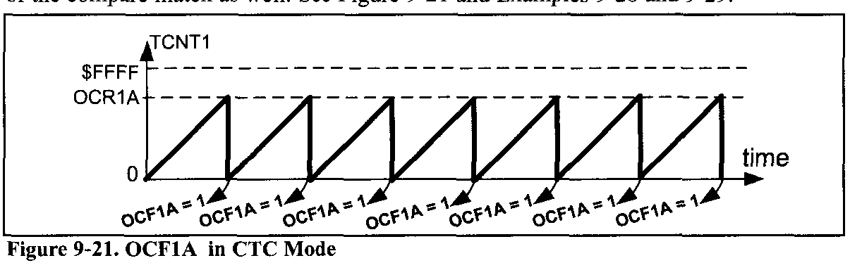
AVR TIMER PROGRAMMING IN ASSEMBLY 9.1 PROGRAMMING TIMERS 0,1 AND 2
CTC mode (WGM13:10 = 0100)
In mode 4, the timer counts up until the content of the TCNT1 register becomes equal to the content of OCR1A (compare match occurs); then, the timer will be cleared when the next clock occurs. The OCF1A flag will be set as a result of the compare match as well.

Slide 73
AVR TIMER PROGRAMMING IN ASSEMBLY 9.1 PROGRAMMING TIMERS 0,1 AND 2
Example 9-26
Find the values for TCCR1A and TCCR1B if we want to program Timer1 in mode 0 (Normal), with no prescaler. Use AVR's crystal oscillator for the clock source.
Solution:
TCCR1A = 0000 0000 WGM11 = 0, WGM10 = 0
TCCRIB = 0000 0001 WGM13 = 0, WGM12 = 0,oscillator clock source, no prescaler

Slide 74

AVR TIMER PROGRAMMING IN ASSEMBLY 9.1 PROGRAMMING TIMERS 0,1 AND 2
Example 9-27
Find the frequency of the square wave generated by the following program if XTAL=8MHz. In your calculation do not include the overhead due to instructions in the loop.

Slide 75
AVR TIMER PROGRAMMING IN ASSEMBLY 9.1 PROGRAMMING TIMERS 0,1 AND 2
Solution:
WGM13:10 = 0000 = 0x00, so Timer1 is working in mode 0, which is Normal mode, and the top is 0xFFFF.
FFFF + 1 - D8F0 = 0x2710 = 10,000 clocks,
which means that it takes 10,000 clocks. As XTAL = 8 MHz each clock lasts 1/(8M) = 0.125 µs and delay = 10,000 × 0.125 µs = 1250 µs = 1.25 ms and frequency = 1 / (1.25 ms x 2) = 400 Hz. In this calculation, the overhead due to all the instructions in the loop is not included.
Notice that instead of using hex numbers we can use HIGH and LOW directives:
LDI R20,HIGH(65535-10000)
OUT TCNT1H,R20
LDI R20,LOW(65535-10000)
OUT TCNT1L,R20
Or we can simply write it as follows:
LDI R20,HIGH(-10000)
OUT TCNT1H,R20
LDI R20,LOW(-10000)
OUT TCNT1L,R20

Slide 76
AVR TIMER PROGRAMMING IN ASSEMBLY 9.1 PROGRAMMING TIMERS 0,1 AND 2
Example 9-28
Find the values for TCCR1A and TCCR1B if we want to program Timer1 in mode 4 (CTC, Top = OCR1A), no prescaler. Use AVR's crystal oscillator for the clock source.
Solution:
TCCR1A = 0000 0000 WGM11 = 0, WGM10 = 0
TCCR1B = 0000 1001 WGM13 = 0, WGMI2 = 1, oscillator clock source, no prescaler

Slide 77

AVR TIMER PROGRAMMING IN ASSEMBLY 9.1 PROGRAMMING TIMERS 0,1 AND 2
Example 9-29
Find the frequency of the square wave generated by the following program if XTAL = 8 MHz. do not include the overhead due to instructions in the loop.

Slide 78

AVR TIMER PROGRAMMING IN ASSEMBLY 9.1 PROGRAMMING TIMERS 0,1 AND 2
Solution:
WGM13:10 = 0100 = 0x04 therefore, Timer1 is working in mode 4, which is a CTC mode, and max is defined by OCR1A.
159 + 1 = 160 clocks
XTAL = 8 MHz, so each clock lasts 1/(8M) = 0.125 μs.
Delay = 160 x 0.125 μs = 20 μs and frequency = 1 / (20 μs x 2) = 25 kHz.

Slide 79
AVR TIMER PROGRAMMING IN ASSEMBLY 9.1 PROGRAMMING TIMERS 0,1 AND 2
Accessing 16-bit registers
The AVR is an 8-bit microcontroller, which means it can manipulate data 8 bits at a time, only. But some Timer1 registers, such as TCNT1, OCR1A, ICR1, and so on, are 16-bit; in this case, the registers are split into two 8-bit registers, and each one is accessed individually. This is fine for most cases. For example, when we want to load the content of SP (stack pointer), we first load one half and then the other half, as shown below:
LDI R16,0x12
OUT SPL,R16
LDI R16,0x34
OUT SPH,R16 ;SP = 0x3412
In 16-bit timers, however, we should read/write the entire content of a register at once, otherwise we might have problems.

Slide 80

AVR TIMER PROGRAMMING IN ASSEMBLY 9.1 PROGRAMMING TIMERS 0,1 AND 2
For example, imagine the following scenario:
The TCNT1 register contains 0x15FF. We read the low byte of TCNT1, which is 0xFF, and store it in R20. At the same time a timer clock occurs, and the content of TCNT1 becomes 0x1600; now we read the high byte of TCNT1, which is now 0x16, and store it in R21. If we look at the value we have read, R21 :R20 = 0x16FF. So, we believe that TCNT1 contains 0x16FF, although it actually contains 0x15FF.
The AVR designers have resolved this issue with an 8-bit register called TEMP, which is used as a buffer.

Slide 81

AVR TIMER PROGRAMMING IN ASSEMBLY 9.1 PROGRAMMING TIMERS 0,1 AND 2
For example, consider the following program:
After the execution of “OUT TCNT1H, R16”, the content of R16, 0x15, will be stored in the TEMP register. When the instruction “OUT TCNT1L, R16” is executed, the content of R16, 0xFF, is loaded into TCNT1L, and the content of the TEMP register, 0x15, is loaded into TCNT1H. So, 0x15FF will be loaded into the TCNT1 register at once.
We should first write into the high byte of the 16-bit registers and then write into the lower byte. Otherwise, the program does not work properly.

Slide 82
AVR TIMER PROGRAMMING IN ASSEMBLY 9.1 PROGRAMMING TIMERS 0,1 AND 2
When we read the low byte of 16-bit registers, the content of the high byte will be copied to the TEMP register. So, the following program reads the content of TCNT1 :
We must pay attention to the order of reading the high and low bytes of the 16-bit registers.

Slide 83
AVR TIMER PROGRAMMING IN ASSEMBLY 9.1 PROGRAMMING TIMERS 0,1 AND 2
Notice that reading the OCR1A and OCR1B registers does not involve using the temporary register. You might be wondering why. It is because the AVR microcontroller does not update the content of OCR1A nor OCR1B unless we update them. For example, consider the following program:
The above code reads the low byte of the OCR1A and then the high byte, and between the two readings the content of the register remains unchanged.
That is why the AVR does not employ the TEMP register while reading the OCR1A/OCR1B registers.

Slide 84

AVR TIMER PROGRAMMING IN ASSEMBLY 9.1 PROGRAMMING TIMERS 0,1 AND 2
Example 9-30
Assuming XTAL = 8 MHz, write a program that toggles PB5 once per millisecond.
Solution:
XTAL = 8 MHz means that each clock takes 0.125 μs. Now for 1ms delay, we need 1ms/0.125μs = 8000 clocks = 0x1F40 clocks. We initialize the timer so that after 8000 clocks the OCF1A flag is raised, and then we will toggle the PB5.

Slide 85

AVR TIMER PROGRAMMING IN ASSEMBLY 9.1 PROGRAMMING TIMERS 0,1 AND 2

Slide 86



AVR TIMER PROGRAMMING IN ASSEMBLY 9.1 PROGRAMMING TIMERS 0,1 AND 2

Slide 87

AVR TIMER PROGRAMMING IN ASSEMBLY 9.1 PROGRAMMING TIMERS 0,1 AND 2
Example 9-31
Rewrite Example 9-30 using the TOV1 flag.
Solution:
To wait 1 ms we should load the TCNT1 register so that it rolls over after 8000 = 0x1F40 clocks. In Normal mode the top value is 0xFFFF = 65535. 65535 + 1 - 8000 = 57536 = 0xE0C0. Thus, we should load TCNT1 with 57536, or 0xE0C0 in hex, or we can simply use 65536 - 8000, as shown below:

Slide 88

AVR TIMER PROGRAMMING IN ASSEMBLY 9.1 PROGRAMMING TIMERS 0,1 AND 2

Slide 89

AVR TIMER PROGRAMMING IN ASSEMBLY 9.1 PROGRAMMING TIMERS 0,1 AND 2

Slide 90

AVR TIMER PROGRAMMING IN ASSEMBLY 9.1 PROGRAMMING TIMERS 0,1 AND 2
Generating a large time delay using prescaler
Size of time delay depends on
Crystal frequency
The timers’s 16-bit register
Both of these factors are beyond the control of the AVR programmer. We can use the prescaler option in the TCCR1B register to increase the delay by reducing the period.
Figure 9-23. Timer/Counter 1 Prescaler
Notes:
As we have seen in the examples so far, the size of the time delay depends on two factors: (a) the crystal frequency, and @) the timer's 16-bit register. Both of these factors are beyond the control of the AVR programmer. We can use the prescaler option in the TCCR1B register to increase the delay by reducing the period. The prescaler option of TCCR1B allows us to divide the instruction clock by a factor of 8 to 1024, as was shown in Figure 9-16. The prescaler of Timer/Counter1 is shown in Figure 9-23.
As we have seen so far, with no prescaler enabled, the crystal oscillator frequency is fed directly into Timer1. If we enable the prescaler bit in the TCCR1B register, then we can divide the instruction clock before it is fed into Timer1. The lower 3 bits of the TCCR1B register give the options of the number we can divide the clock by before it is fed to timer. As shown in Figure 9-23, this number can be 8, 64, 256, or 1024. Notice that the lowest number is 8, and the highest number is 1024. Examine Examples 9-32 and 9-33 to see how the prescaler options are programmed.

Slide 91

AVR TIMER PROGRAMMING IN ASSEMBLY 9.2 COUNTER PROGRAMMING
CS00, CS01, and CS02 bits in the TCCR0 register
When the timer is used as a timer, the AVR's crystal is used as the source of the frequency. When it is used as a counter, however, it is a pulse outside the AVR that increments the TCNTx register.
If CS02:00 is between 1 and 5, the timer gets pulses from the crystal oscillator. In contrast, when CS02:00 is 6 or 7, the timer is used as a counter and gets its pulses from a source outside the AVR chip.
The TCNT0 counter counts up as pulses are fed from pin T0. In ATmega32/ATmegal6, T0 is the alternative function of PORTB.0.

Slide 92
AVR TIMER PROGRAMMING IN ASSEMBLY 9.2 COUNTER PROGRAMMING
Example 9-34
Find the value for TCCR0 if we want to program Timer0 as a Normal mode counter. Use an external clock for the clock source and increment on the positive edge.
Solution:
TCCR0 = 0000 0111 Normal, external clock source, no prescaler
In the case of Timer0, when CS02:00 is 6 or 7, pin T0 provides the clock pulse and the counter counts up after each clock pulse coming from that pin. Similarly, for Timer1, when CS12:10 is 6 or 7, the clock pulse coming in from pin T1 (Timer/Counter 1 External Clock input) makes the TCNT1 counter count up.
When CS12:10 is 6, the counter counts up on the negative (falling) edge. When CS12:10 is 7, the counter counts up on the positive (rising) edge. In ATmega32/ATmegal6, T1 is the alternative function of PORTB.1.

Slide 93


AVR TIMER PROGRAMMING IN ASSEMBLY 9.2 COUNTER PROGRAMMING
Example 9-35
Assuming that a 1Hz clock pulse is fed into pin T0 (PB0), write a program for Counter0 in normal mode to count the pulses on falling edge and display the state of the TCNT0 count on PORTC.

Slide 94



AVR TIMER PROGRAMMING IN ASSEMBLY 9.2 COUNTER PROGRAMMING
Example 9-36
Assuming that a 1Hz clock pulse is fed into pin T0, use the TOV0 flag to extend Timed to a 16-bit counter and display the counter on PORTC and PORTD.

Slide 95


AVR TIMER PROGRAMMING IN ASSEMBLY 9.2 COUNTER PROGRAMMING
Example 9-37
Assuming that clock pulses are fed into pin T1 (PB1), write a program for Counter1 in Normal mode to count the pulses on falling edge and display the state of the TCNT1 count on PORTC and PORTD.

Slide 96

AVR TIMER PROGRAMMING IN ASSEMBLY 9.2 COUNTER PROGRAMMING
Example 9-38
Assuming that clock pulses are fed into pin T1 (PB1) and a buzzer is connected to pin PORTC.0, write a program for Counter 1 in CTC mode to sound the buzzer every 100 pulses.
Solution:
To sound the buzzer every 100 pulses, we set the OCR1A value to 99 (63 in hex), and then the counter counts up until it reaches OCR1A. Upon compare match, we can sound the buzzer by toggling the PORTC.0 pin.

Slide 97

AVR TIMER PROGRAMMING IN ASSEMBLY 9.2 COUNTER PROGRAMMING

Slide 98

AVR TIMER PROGRAMMING IN ASSEMBLY 9.3 PROGRAMMING TIMERS IN C
Example 9-39
Write a C program to toggle all the bits of PORTB continuously with some delay. Use Timer0, Normal mode, and no prescaler options to generate the delay.
Notes:
In C we can access timer registers

Slide 99
AVR TIMER PROGRAMMING IN ASSEMBLY 9.3 PROGRAMMING TIMERS IN C
Calculating delay length using timers
As we saw in the last two sections, the delay length depends primarily on two factors:
the crystal frequency, and
the prescaler factor. A third factor in the delay size is the C compiler because various C compilers generate different hex code sizes, and the amount of overhead due to the instructions varies by compiler.

Slide 100

AVR TIMER PROGRAMMING IN ASSEMBLY 9.3 PROGRAMMING TIMERS IN C
Example 9-40
Write a C program to toggle only the PORTB.4 bit continuously every 70 µs. Use Timer0, Normal mode, and 1:8 prescaler to create the delay. Assume XTAL = 8 MHz.
Solution:
XTAL = 8MHz ⇒ T _{machine cycle}= 1/8 MHz
Prescaler = 1:8 ⇒ T_{clock} = 8 × 1/8 MHz = 1µs
70 µs/1 µs = 70 clocks $4$⇒ 1 + 0xFF - 70 = 0x100 — 0x46 = 0xBA =186

Slide 101

AVR TIMER PROGRAMMING IN ASSEMBLY 9.3 PROGRAMMING TIMERS IN C

Slide 102
AVR TIMER PROGRAMMING IN ASSEMBLY 9.3 PROGRAMMING TIMERS IN C
Example 9-41
Write a C program to toggle only the PORTB.4 bit continuously every 2 ms. Use Timer1, Normal mode, and no prescaler to create the delay. Assume XTAL = 8 MHz.
Solution:
XTAL = 8 MHz ⇒ T_{machine cycle} = 1/8 MHz = 0.125 µs
Prescaler = 1:1 T_{Clock}= 0.125 µs
2 ms/0.125 µs = 16,000 clocks = 0x3E80 clocks
1 + 0xFFFF - 0x3E80 = 0xC180

Slide 103

AVR TIMER PROGRAMMING IN ASSEMBLY 9.3 PROGRAMMING TIMERS IN C

Slide 104
AVR TIMER PROGRAMMING IN ASSEMBLY 9.3 PROGRAMMING TIMERS IN C
Example 9-42 (C version of Example 9-32)
Write a C program to toggle only the PORTB.4 bit continuously every second. Use Timer1, Normal mode, and 1:256 prescaler to create the delay. Assume XTAL = 8 MHz.
Solution:
XTAL = 8 MHz ⇒ T_{machine cycle} = 1/8 MHz = 0.125 µs = T_{Clock}
Prescaler 1:256 ⇒ T_{Clock} = 256 x 0.125 µs = 32 µs
1s/32 µs = 31,250 clocks = 0x7Al2 clocks ⇒ 1 + 0xFFFF - 0x7Al2 = 0x85EE

Slide 105

AVR TIMER PROGRAMMING IN ASSEMBLY 9.3 PROGRAMMING TIMERS IN C

Slide 106


AVR TIMER PROGRAMMING IN ASSEMBLY 9.3 PROGRAMMING TIMERS IN C
C programming of Timers 0 and 1 as counters
Timers can be used as counters if we provide pulses from outside the chip instead of using the frequency of the crystal oscillator as the clock source. By feeding pulses to the T0 (PB0) and T1 (PB1) pins, we use Timer0 and Timer1 as Counter 0 and Counter 1, respectively.
Example 9-43 (C version of Example 9-36)
Assuming that a 1 Hz clock pulse is fed into pin T0, use the TOV0 flag to extend Timer0 to a 16-bit counter and display the counter on PORTC and PORTD.

Slide 107

AVR TIMER PROGRAMMING IN ASSEMBLY 9.3 PROGRAMMING TIMERS IN C

Slide 108


AVR TIMER PROGRAMMING IN ASSEMBLY 9.3 PROGRAMMING TIMERS IN C
Example 9-44 (C version of Example 9-37)
Assume that a 1-Hz external clock is being fed into pin T1 (PB1). Write a C program for Counter1 in rising edge mode to count the pulses and display the TCNT1H and TCNT11, registers on PORTD and PORTC, respectively.

